Slide 1
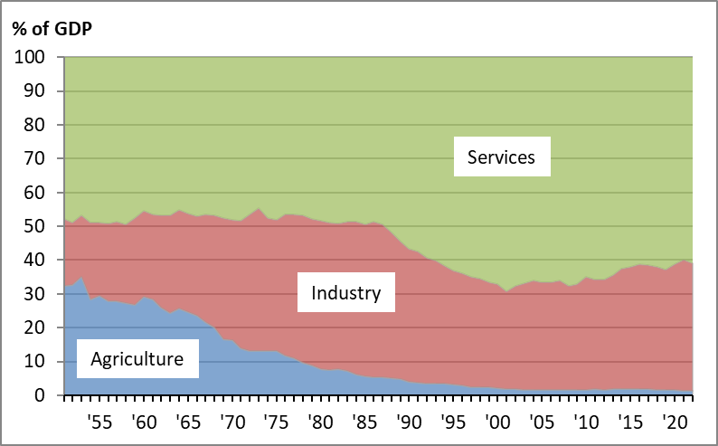
Chart 4.1 GDP by Sector, Taiwan, 1951-2022
Notes:
Data source: https://eng.stat.gov.tw/cp.aspx?n=2334

